Slide 1


BOARD OF TRUSTEES
JANUARY 15, 2016

Slide 2
DR. RON INGLE
Interim
Provost/Vice President
for Academic Affairs

Slide 3

ACCREDITATION UPDATE
SACSCOC Level Change report due January 18, 2016
Onsite Visit
March 1-3, 2016

Slide 4

ACCREDITATION UPDATE
Reaffirmation report and initial accreditation application for Accounting was submitted in December
ACBSP Onsite Visit
February 14-17, 2016

Slide 5

GRADUATE PROGRAM
M.S. in Global Logistics
and Supply Chain Management
Implemented Spring 2016
Two classes offered with 7 students
M.A. in Religious Studies
Scheduled to be implemented in Fall 2016
M.Ed. in Career and Technical Education
Waiting on ACHE approval
Scheduled to be implemented in Fall 2017

Slide 6
FACULTY/STAFF POSITIONS
Provost/Vice President for Academic Affairs
Search Update
Question/Answer Forum
Friday, January 22, 2016 2:00 pm – 3:30 pm
Friday, January 29, 2016 2:00 pm – 3:30 pm
Tuesday, February 2, 2016 2:00 pm – 3:30 pm
Friday, February 5, 2016 2:00 pm – 3:30 pm
Friday, February 12, 2016 2:00 pm – 3:30 pm

Slide 7
FACULTY/STAFF POSITIONS
Faculty – 4 full-time faculty positions
1 in College of Arts and Sciences – Computer Science
1 in College of Business – Logistics Management
2 in College of Education – English Language Learner (ELL) and Secondary History/Social Studies Education

Slide 8


HIGHLIGHTS
Athens State University
Institution of Management Accountants (IMA)
Received 3 awards at IMA Student Leadership Conference
        Outstanding Student Chapter
        Best Communications
        IMA Gold Award of Excellence
Athens State University Alpha Iota Chapter of
Delta Mu Delta recognized as a Star Chapter at
DMD biennial conference

Slide 9


HIGHLIGHTS
Athens State University’s online Bachelor of Science in
Human Resource Management recognized by
OnlineColleges.net as one of the best in the country.
Athens State University Testing Center named a
Certified Testing Center by the National College
Testing Association.

Slide 10
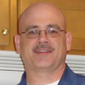
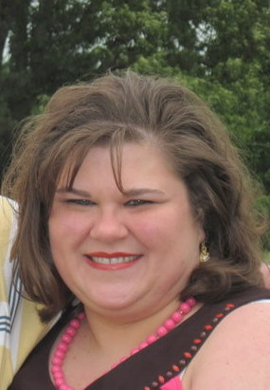
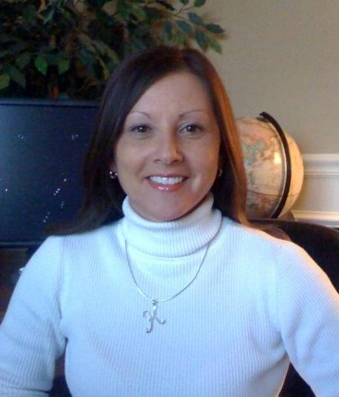
HIGHLIGHTS
3 faculty members earned doctorate degree
Dr. Scott Cox
College of Business
Dr. Leigh Hester
College of Education
Dr. Kim Roberts
College of Business

Slide 11


HIGHLIGHTS
College of Education hosted the 2nd Annual We TEACH Conference
$75,000 grant awarded to Athens State University by Appalachian Regional Commission to assist with TEAM: Tying Excellence with Accountability Mentoring.

Slide 12

HIGHLIGHTS
Successfully hosted numerous first-time Professional
Development Training Courses, including:
  “Accounting Updates Forum” for CPA’s in the North Alabama area.
  “ISO 9001:2015” Quality Management System Transition Course
  for local manufacturing engineers and management.
  “Basic Archery Instructor Training” course for Physical Education
  Teachers in the North Alabama area
  Co-sponsored Merry Market promoting local
  home-based businesses with the Athens Chamber of Commerce

Slide 13
HIGHLIGHTS
  Co-sponsored “Committed” for a Holiday Concert in McCandless Hall (in conjunction with the Livingston Concert Lecture Series). Committed is a nationally award-winning a cappella group, Season Two Champions of NBC’s Sing-Off, and current Grammy Award nominees. SOLD OUT CONCERT!
  ServSafe Professional Training for the Food Service Industry continues to be a popular course, with maximum capacity attendees monthly.

Slide 14
HIGHLIGHTS
  The CLL had a net income of + $12, 112.22 for the October-December 2015 timeframe, AFTER accounting for operating expenses. This represents a significant increase in contrast to the same timeframe (October-December) of 2014, wherein the CLL suffered a loss of - $1,933.09, after accounting for operating expenses.

Slide 15
HIGHLIGHTS
  Will host a 9-week "Business 101" course for entrepreneurs in the North Alabama area in Spring 2016. Co-Sponsoring with the Decatur-Morgan County Entrepreneurial Center.
Will host “Women’s Leadership Symposium” on March 2
at Dynetics (Conference Room) in Huntsville.

Slide 16
MR. MIKE MCCOY
Vice President
For
Financial Affairs

Slide 18
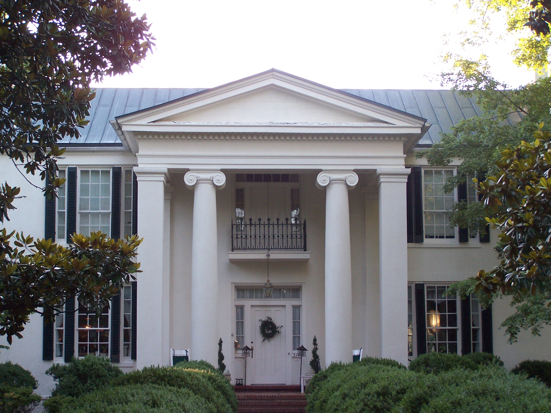
CAMPUS PROJECTS
  Work continues on the building exterior and includes repairs on windows, roof and brick along with improvements to landscaping and grounds.
  New electrical system, heating and cooling system and water/sewer system have been completed as part of Phase II renovations.
BEATY MASON

Slide 19

CAMPUS PROJECTS
HOUSTON HALL
  Preliminary design for removing Houston Hall and renovating the east side of Founders Hall has completed review by the Alabama Building Commission.
  Final design work continues and must be approved by the Alabama Building Commission as part of the final review.

Slide 20

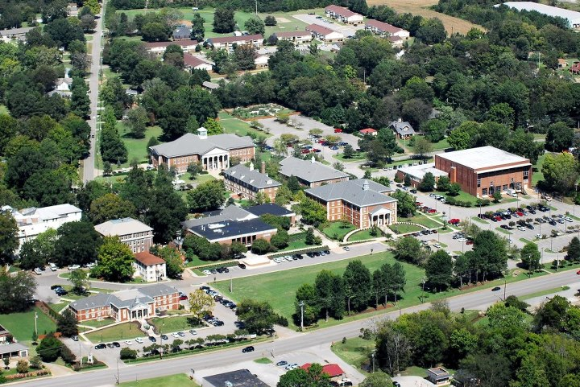

CAMPUS PROJECTS
CAMPUS SECURITY UPDATE
Active shooter Training for University employees was conducted during
the month of November.
University emergency
notification system is
being upgraded
and communicated
to all faculty, staff and
students.
FACILITIES MASTER PLAN
  Contract for University FMP awarded to Goodwyn, Mills and Cawood, Inc. with estimated completion date of June 2016.

Slide 21
DR. KEITH FERGUSON
Vice President for
University Advancement

Slide 22
FUNDRAISING UPDATE
June 1, 2015 through December 31, 2015
For the period of June 1, 2015 through the end of December we received $170,870 in contributions from 594 donors. Of this amount, $1,827 was in the form of non-cash donations.

Slide 23
CAPITAL CAMPAIGN

Slide 24

SCHOLARSHIPS
Foundation Scholarships for 2015-2016 $140,764 has been awarded to 152 students
Alumni Scholarships for 2015-2016
$38,445 has been awarded to 32 students

Slide 25
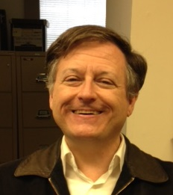
TIM DEMPSEY
DIRECTOR OF
PROSPECT MANAGEMENT

Slide 26
MS. SARAH MCABEE
Vice President
for
Enrollment and Student Services

Slide 27

SPRING 2016
GRADUATE ENROLLMENT
134 prospective students
26 applications received
8 students admitted
6 students enrolled

Slide 28
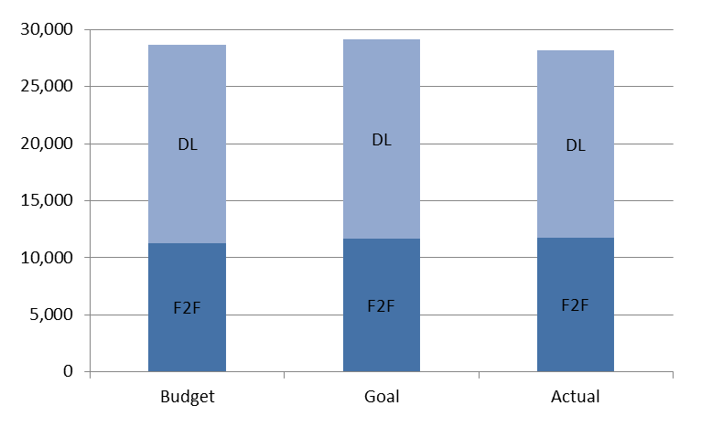
SPRING 2016 ENROLLMENT
(As of January 8, 2016)
 | BUDGET | GOAL | ACTUAL
Face to Face | 11,289 | 11,660 | 11,715
DL | 17,348 | 17,490 | 16,440
TOTAL | 28,637 | 29,150 | 28,155
New Students | 459 |  | 423
Ended Regular Registration
-482 from budget goal
-995 from EM goal 2% increase
Non-Payment Deletions on 1-8-2016 256 students with 2068 Credit hours

Slide 29
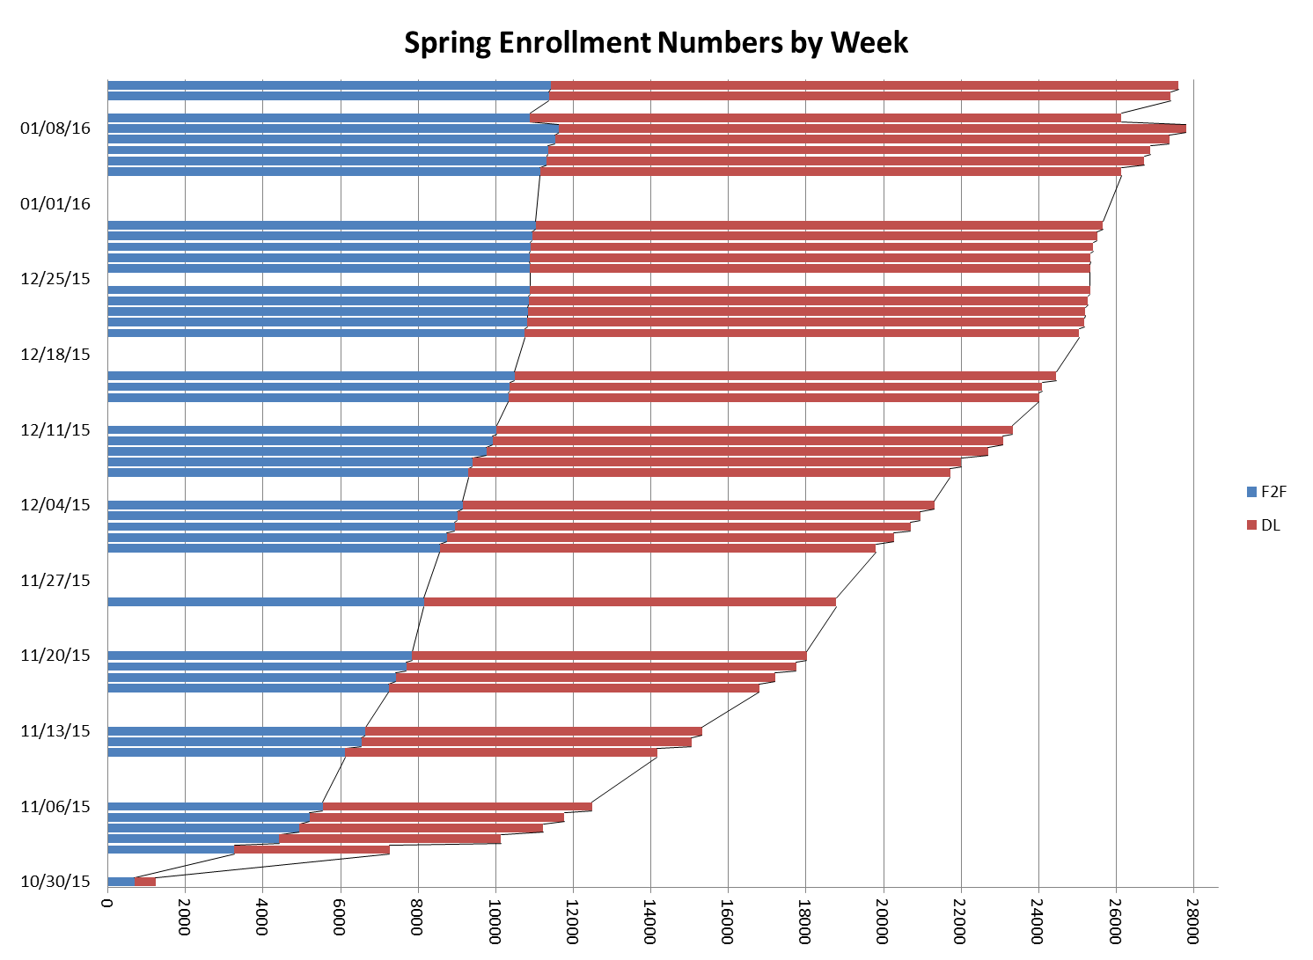

Slide 30

“I recommend any student who is considering taking classes at Athens State University to do this now! Don't wait! I just finished the process today, and it was incredibly easy and fun! Within just an hour a message was sent to my email confirming my enrollment! :)”
Facebook comment from Cody Gibson

Slide 31
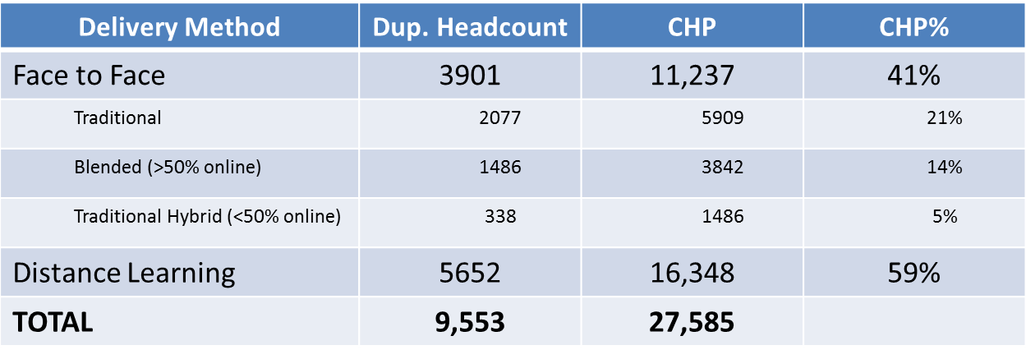
HEADCOUNT BY
DELIVERY METHOD as of January 13, 2016
(with 2 days of late registration)

Slide 32
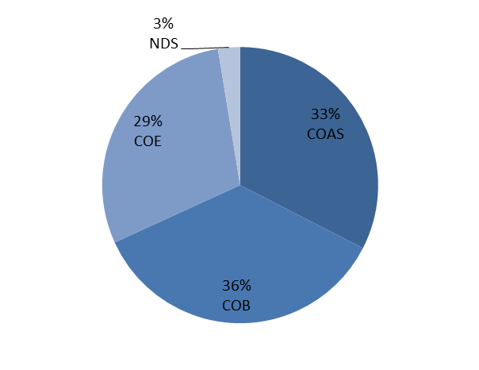
SNAPSHOT OF SPRING REGISTRATION as of January 8, 2016
College | Headcount | Credit Hours
Arts & Sciences | 935 | 9159
Business | 1065 | 10028
Education | 751 | 8242
No College | 162 | 726
Total | 2913 | 28,155
New Students: 423

Slide 33
ENROLLMENT GOALS FOR 2016
2% increase enrollment over 2015 actual
TERM | GOAL
Spring 2016 | 29,150
Summer 2016 | 14,613
Fall 2016 | 29,042
TOTAL | 72,805

Slide 34
MS. BELINDA KRIGEL
Chief Information Officer

Slide 35
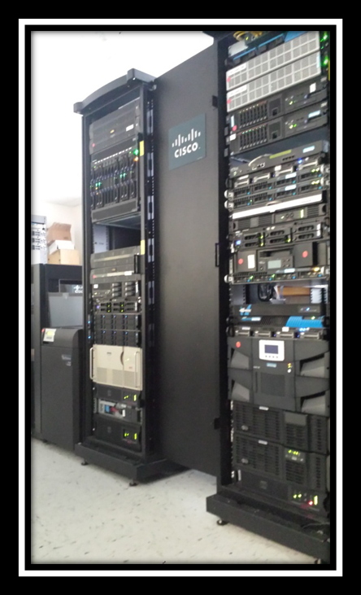
Update: 2015-16 IT Initiatives
INFORMATION TECHNOLOGY SERVICES
Security, Redundancy and Scalability
56 servers virtualized
Enterprise level backup of data to offsite facility
Cloud storage for e-mail archiving
Active Directory upgraded to R2

Slide 36
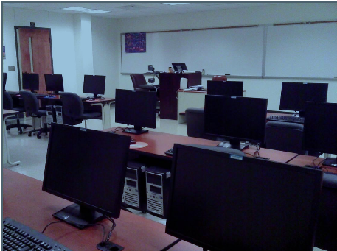
Update: 2015-16
Academic Technology Services
INFORMATION TECHNOLOGY SERVICES
Quality Matters Initiative
Midway to completion
3 Faculty formally, 6 others attending training voluntarily
Goal is to have a redesigned course that can be certified plus faculty able to share their knowledge

Slide 37
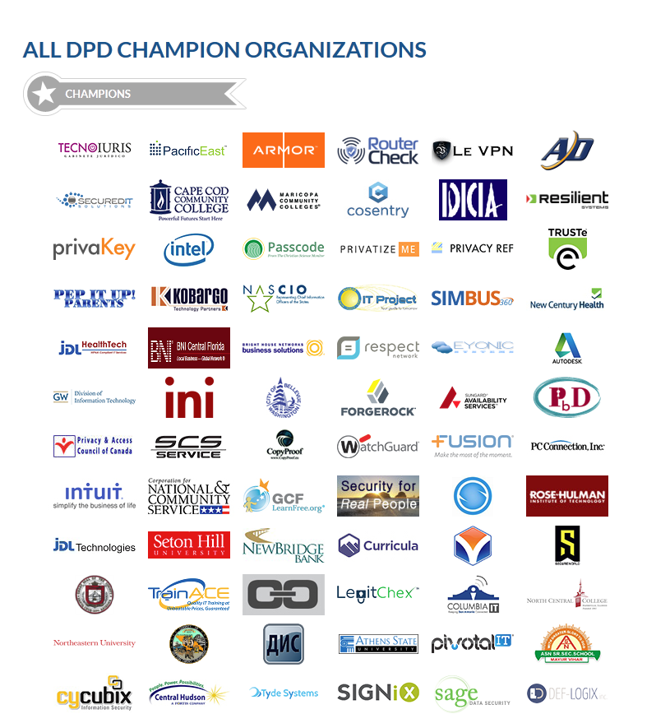
INFORMATION TECHNOLOGY SERVICES
National Data Privacy Day
https://www.staysafeonline.org/data-privacy-day/

Slide 38
DR. MICHAEL ESSARY
Presiding Officer
Faculty Senate

Slide 39
POLICIES AFFIRMED BY THE FACULTY SENATE
Transfer and Acceptance of Academic Credit
Standards of Academic Performance
ASU Grading System
General University Requirements for Graduation
Withdrawal from Courses
Course Hour Load/Course Overload
Repetition of Courses
Curriculum Review
Awarding of Degrees Posthumously
Faculty Credentials
Determination of Credit Hours
Academic Honors and Awards
Awarding Honorary Degrees
Sabbatical Leave
Second Degrees and Double or Additional Majors

Slide 40
MR. STEVE CLARK
Presiding Officer
Staff Senate

Slide 41

RECENT BENEVOLENCE
December 2015: Athens State staff sponsored four Limestone County area children through the Department of Human Resources, unselfishly giving in excess of $1,000 in gifts and cash to ensure these children (ages 5, 7, 11 & 15) had a very memorable Christmas.

Slide 42


UPCOMING ACTIVITIES
February 2016: Valentines Day Carnations sale with proceeds going to Limestone County Churches Involved (LCCI), benefiting area families living in poverty.
April 2016: Annual Staff Appreciation Luncheon, honoring the “Outstanding Staff Member” for 2016.

Slide 43
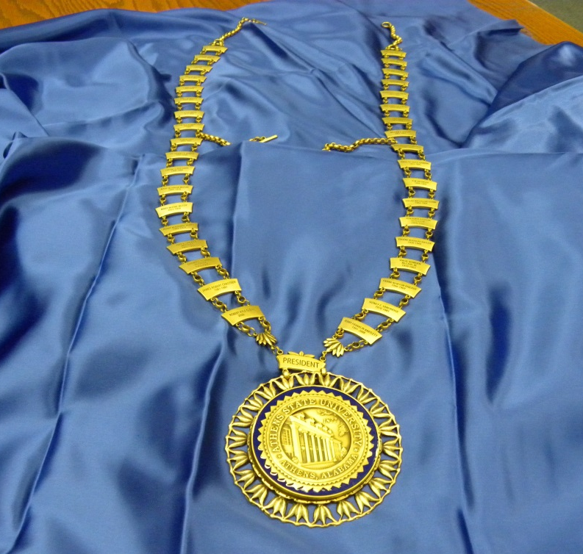
DR. ROBERT GLENN
President

Slide 44

ANNOUNCEMENTS
Statement of Economic Interests
Due April 30, 2016
www.ethics.alabama.gov
Please send confirmation of completion to Jackie Gooch

Slide 45

ANNOUNCEMENTS
2016 National Conference on Trusteeship
April 17-19, 2016
Gaylord National Harbor Resort & Convention Center
Washington, D.C.

Slide 46

ANNOUNCEMENTS
LEVEL CHANGE COMMITTEE VISIT
March 1 – 3, 2016
Tentative Meeting with Board Chair
Tuesday, March 1, 2016
3:30 pm – 5:30 pm

Slide 47



