Slide 1
Board of Trustees Meeting
July 17, 2015

Slide 2
DR. RON INGLE
Interim
Provost/Vice President for Academic Affairs

Slide 3
ACCREDITATION UPDATE
College of Business
ACBSP self-study will be conducted in 2015
with site visit to occur in 2016

Slide 4
ACCREDITATION UPDATE
College of Arts and Sciences
Computer Science Dept. is seeking Accreditation from the Board for Engineering and Technology (ABET)
Self-study submitted in June
Site visit planned for September

Slide 5
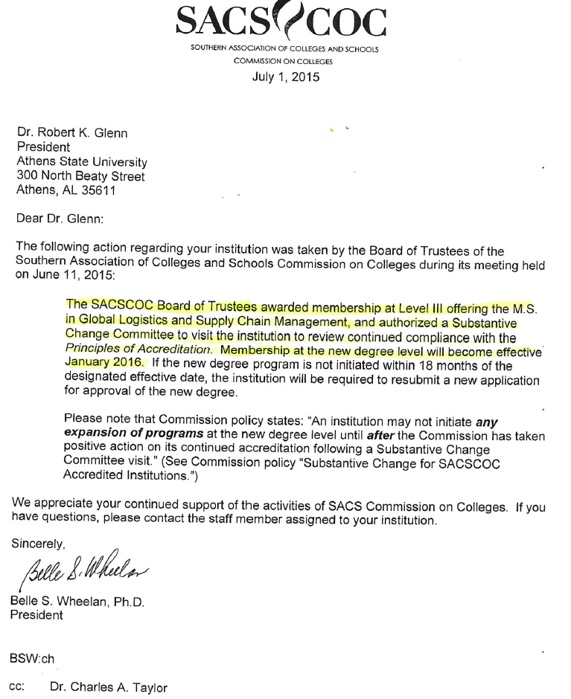

Slide 6
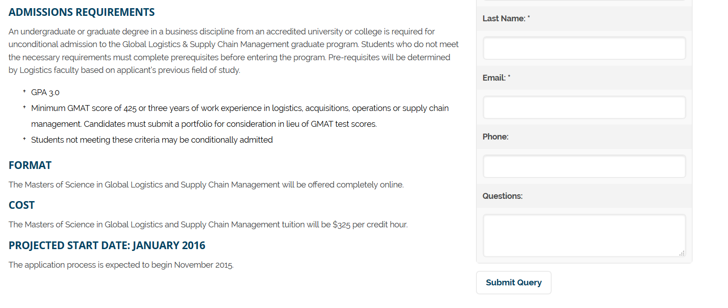
GRADUATE PROGRAM
Landing page for graduate program inquiries
Over 80 prospects have used this tool and each one receives a personal response
Can also access graduate information from main webpage under
Future students
Academics
College of Business
www.athens.edu/masters

Slide 7
Approved the M.A. in Religious Studies
on June 12, 2015
Approved the following certificate programs:
Aviation Management
Management of Technology
Program Management
Educational Technology
English Language Learner (ELL)
Instructional Design
Instructional Technology

Slide 8
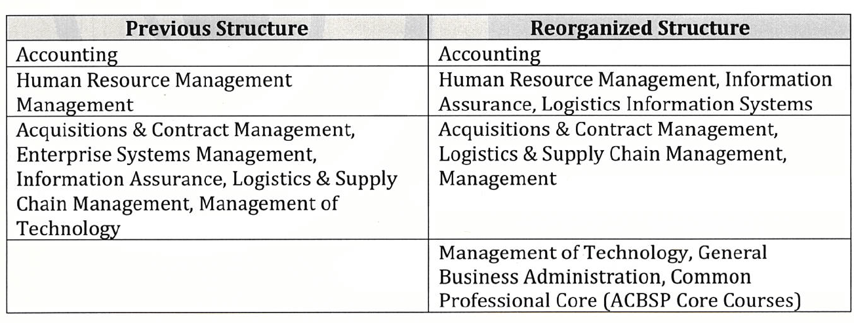
RESTRUCTURE
ACADEMIC DEPARTMENTS
College of Business

Slide 9
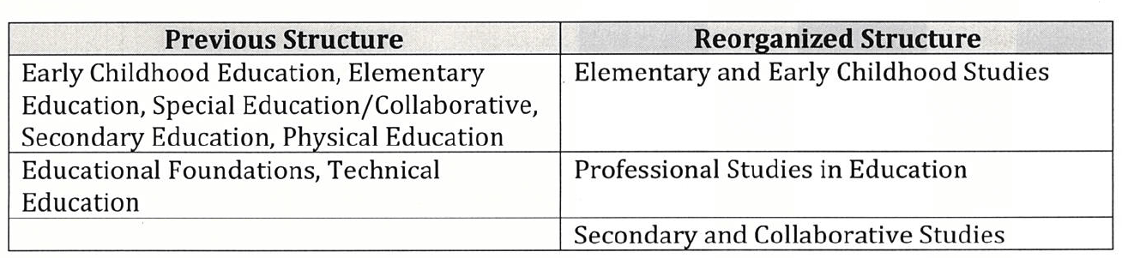
RESTRUCTURE
ACADEMIC DEPARTMENTS
College of Education

Slide 10
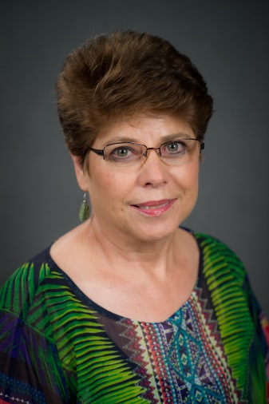
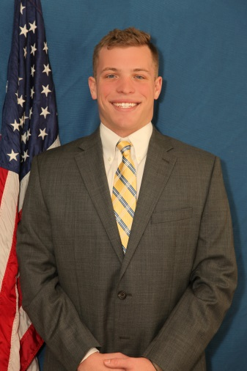
HIGHLIGHTS
COLLEGE OF BUSINESS
Accounting Program ranked #16 in the Top 50 listing of online accounting programs in U.S. according to
Online Accounting Degrees
Two students (Diane Hammond and Austin Ray) received 1st place and 2nd
place for their presentations at the
2015 Annual Meeting of the
Alabama Academy of Science.

Slide 11
HIGHLIGHTS
COLLEGE OF BUSINESS
Phi Theta Kappa International Honor Society Alumni Chapter- National Alumni Award of Merit awarded at PTK Conference in April
Society for Human Resource Management (SHRM) awarded the 2014-2015 Outstanding Student Chapter Award to the Athens State University SHRM student chapter.

Slide 12
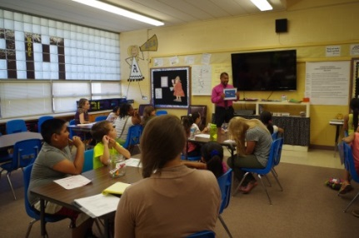
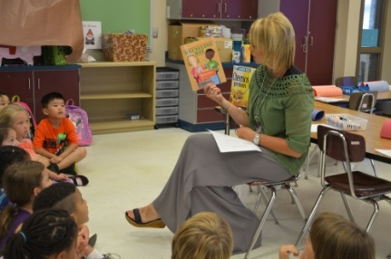
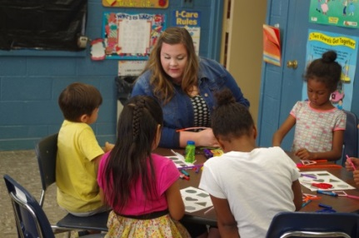
HIGHLIGHTS
COLLEGE OF EDUCATION
New Teacher Candidate Training Opportunities
Hosted two week summer program for over 40 elementary
School students at Athens Elementary School.
The focus of the program was English Language Learners
(ELL) and Reading Integration for grades 1st through 4th.
The COE and the COAS faculty partnered with Decatur City schools
to host the first camp that focused specifically on middle school students.
A two-week, on campus educational experience for students from
Cedar Ridge, Oak Park, and Brookhaven Middle Schools.
Participants were high achieving students eligible for advanced classes.
The curriculum focused on math, science, literature, and theatre.

Slide 13
MR. MIKE MCCOY
Vice President for Financial Affairs

Slide 15
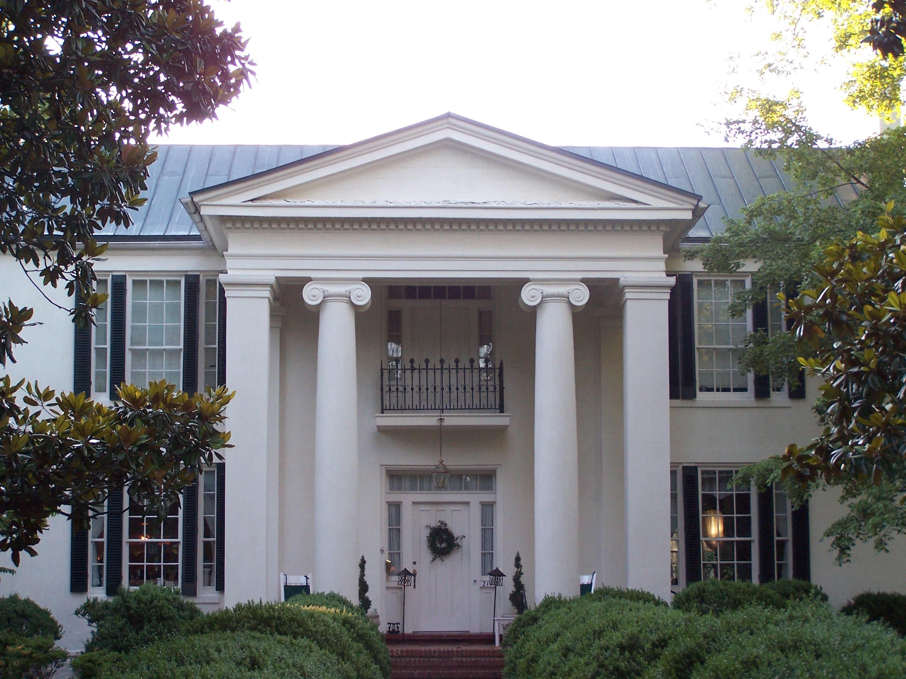
CAMPUS PROJECTS UPDATE
BEATY MASON
The construction work Phase II of the project is progressing on schedule to be completed in the fall. This consists of new HVAC, new electrical, new water and sewer, structural changes, subfloors, and wall modification
Work on the front entrance sidewalk is planned to start next week
Refurbished windows are being repainted and will be replaced when subfloor work is completed
Contractors are in place to prep and paint the roof

Slide 16
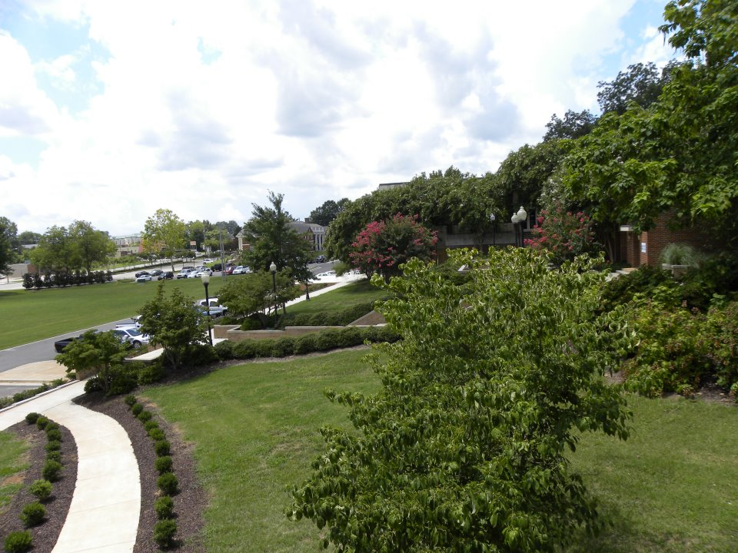
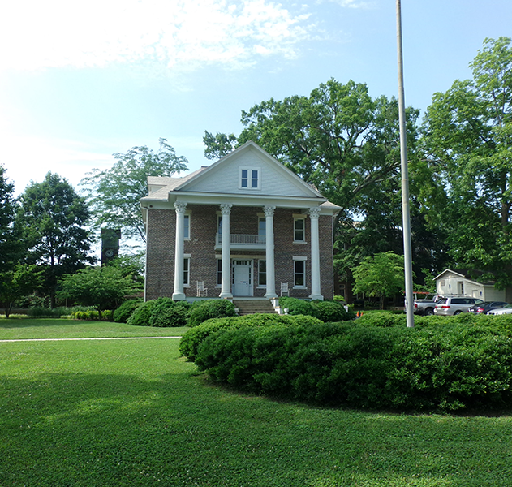
CAMPUS PROJECTS
LANDSCAPING
All campus landscaping has been renewed
BROWN HALL
Now vacant
Heating, cooling, and lighting levels have been set back to minimum to reduce energy consumption

Slide 17
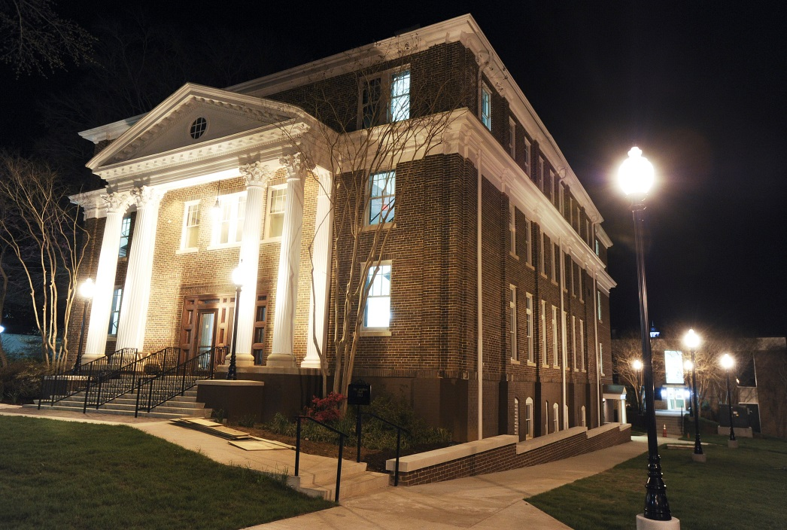
CAMPUS PROJECTS
MCCANDLESS HALL
The Commissioning Agent is scheduled
to make final inspection next week.
Employees from Brown Hall have
been relocated into this building.
Demolition work in the basement
has started for construction of a space
for displaying the Delmore Collection
now located in Carter Hall. This is
expected to be complete and operational
prior to Fiddler’s Weekend.
The exterior landscaping is underway.
There are a few plants that will be added this fall.

Slide 18
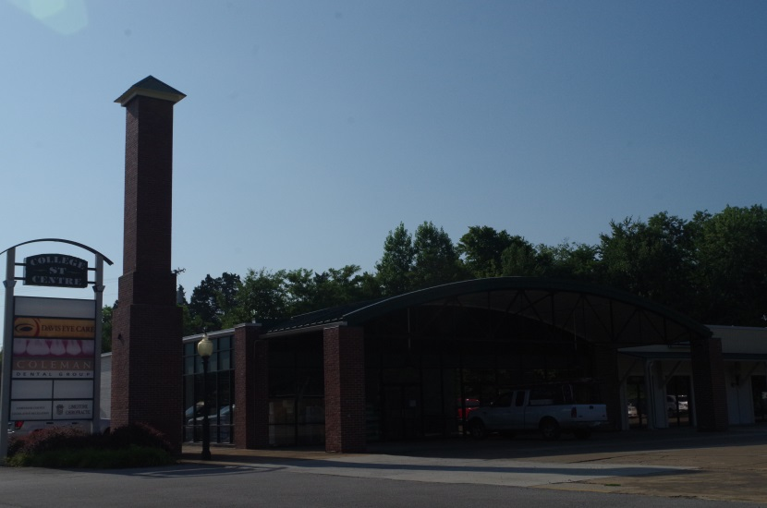
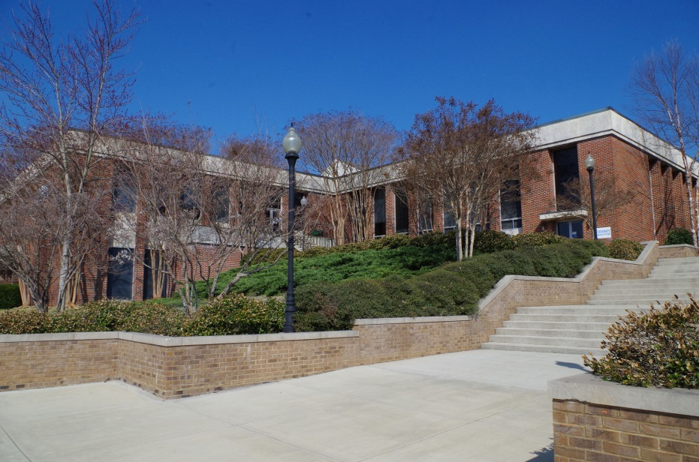
CAMPUS PROJECTS
COLLEGE STREET CENTER
The expansion of the space for Dr. Davis is nearing completion.
The upgrades to the landscape have been delayed until fall.
SANDRIDGE STUDENT UNION
Specifications are being prepared for a new fire alarm system. This project will be bid.
Plans are being developed for adding surveillance cameras in this building.

Slide 19
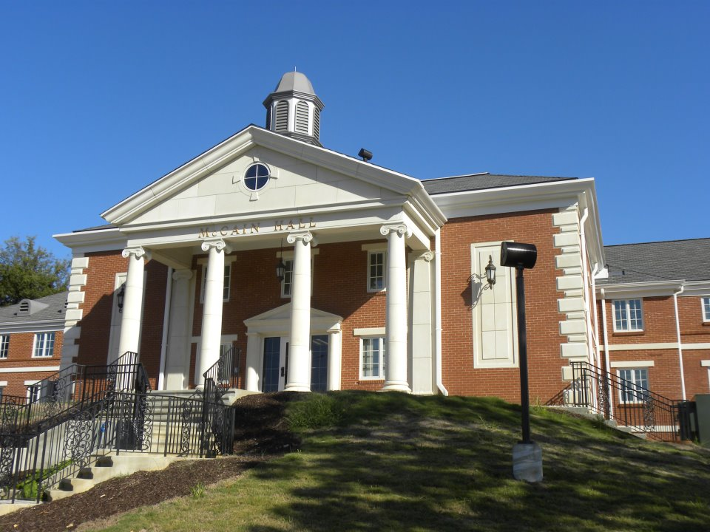
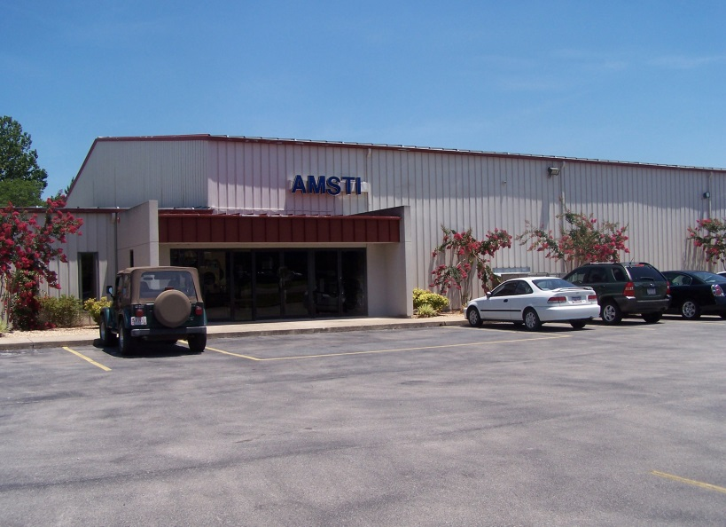
CAMPUS PROJECTS
MCCAIN HALL
The sewer line for McCain has been replaced. The contractor will be back in a few weeks to finish landscape work.
Plans are being developed for repaving the parking areas south and east of McCain.
AMSTI BUILDING
Surveillance cameras are being installed inside and outside the building.

Slide 20
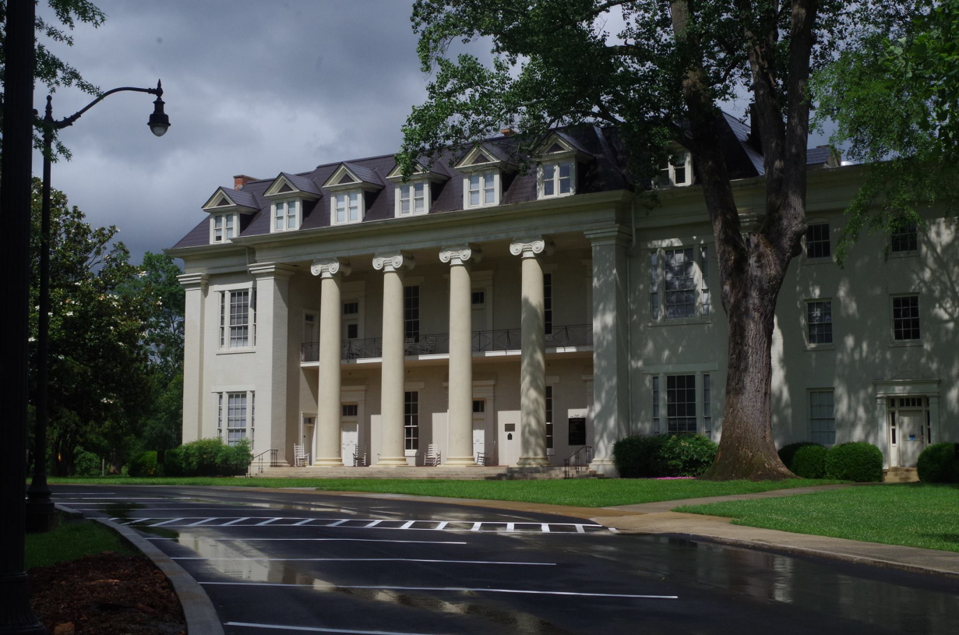
CAMPUS PROJECTS
FOUNDERS HALL
New curbs and paving have been completed. The landscaping along the backside of the curbs is in progress.
Plans are being developed to repave the street and parking on the south side of Founders.
LED lights are being installed in place of incandescent lights.

Slide 21
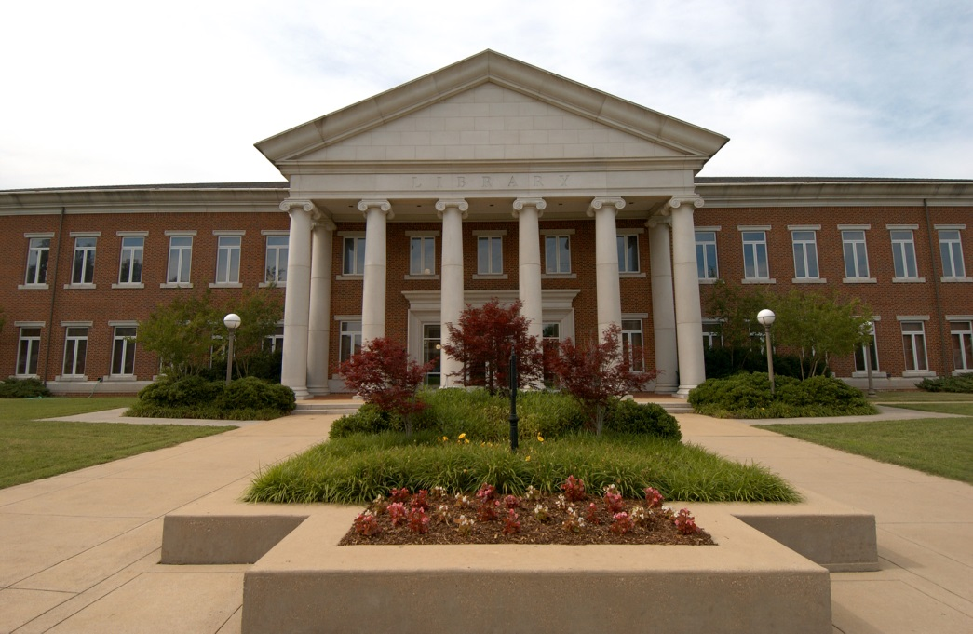
CAMPUS PROJECTS
LIBRARY
Bid specifications are being developed for new energy efficient lamps and ballasts to upgrade the entire building. This would result in an electrical savings as these lights burn many hours at night and the difference in wattage is tremendous.

Slide 22
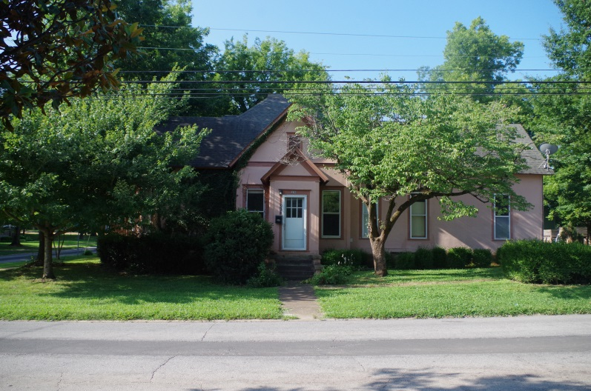
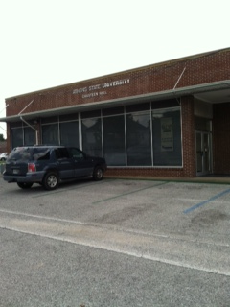
CAMPUS PROJECTS
311 Pryor Street House
Bid specifications are being developed for removal of this house from the property.
CHASTEEN HALL
The City of Athens is reworking the street corner and east entrance to this property primarily for safety.
We are developing plans to correct some drainage issues with water entering the building. This will allow more green space around the building and will allow improvements in the landscaping and appearance of the building.

Slide 23
MS. SARAH MCABEE
Vice President for
Enrollment and Student Services

Slide 24
2014/15 CREDIT HOUR PRODUCTION ACTUAL vs. BUDGET
Notes:
Over Fall 1143
Over Spring 885
Under Summer 163
**DL hrs were up more than expected Fall and Spring, down more than expected Summer
2014/2015 year to date FA disbursed:
Pell $5,359,574
Loans $14,288,075
Summer Final 2045 students with 14,437 credit hours
Fiscal Budget 14,600
AY 2015 Credit Hour Production 73, 205

Slide 25
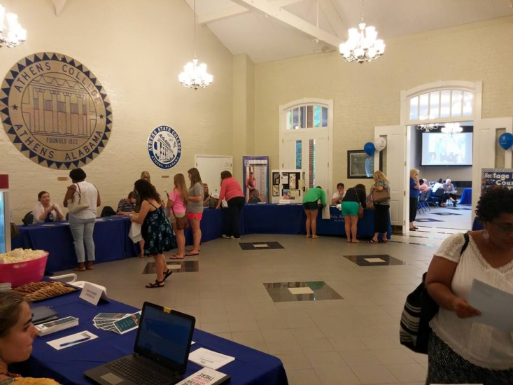
FALL 2015 ENROLLMENT
(As of July 10, 2015)
Credit Hours = 19,367
Fiscal Budget 30,292
Total Headcount = 2013
Fiscal Budget 3190
334 New Students

Slide 26
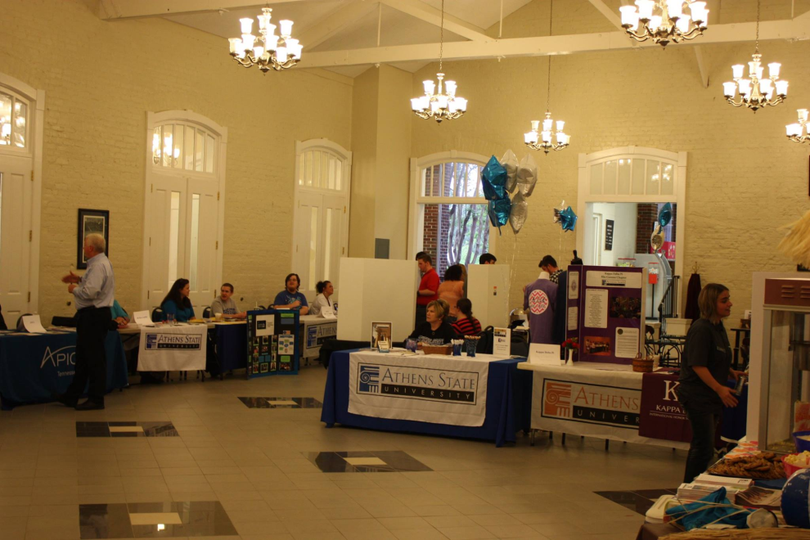
AREA UPDATES
Enrollment Management Plan
Report Card delivered to Student Affairs Committee
2015/16 EMP October Board meeting
Degree Works
Initial Training complete
Available for Fall advising
Fall Transfer Orientation Day—July 14

Slide 27
AREA UPDATES
Fall Recruiting
2 new Admissions Advisors hired July 6
45 High School Fairs planned
11 College Fairs planned
Career Development Center
5 events planned for fall semester
(Resume 101, LinkedIn, Career Chats and Career Fair)
Beasley Field Festival
Welcome Back event planned for August 20
Live music, food and fun!
Notes:
Made offers for 3 new advisors

Slide 28
MS. BELINDA KRIGEL
Chief Information Officer

Slide 29
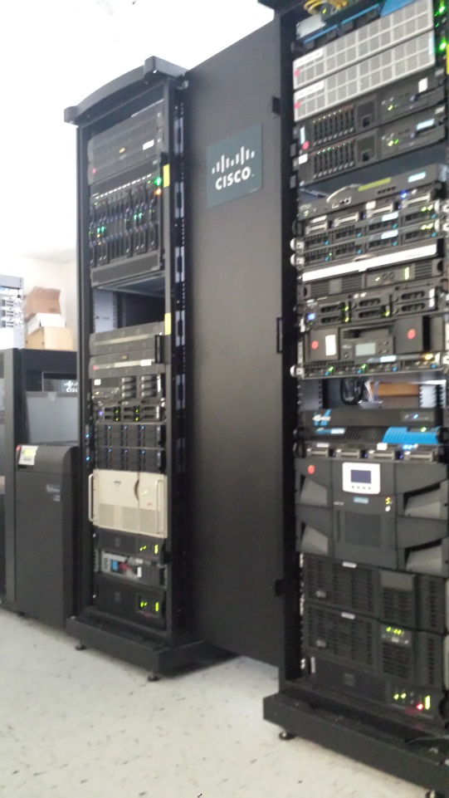
INFORMATION TECHNOLOGY SERVICES
Summer 2015 Projects Data Room Upgrade CISCO Blade Center EMC storage Banner system platform transition Wireless network upgrade

Slide 30
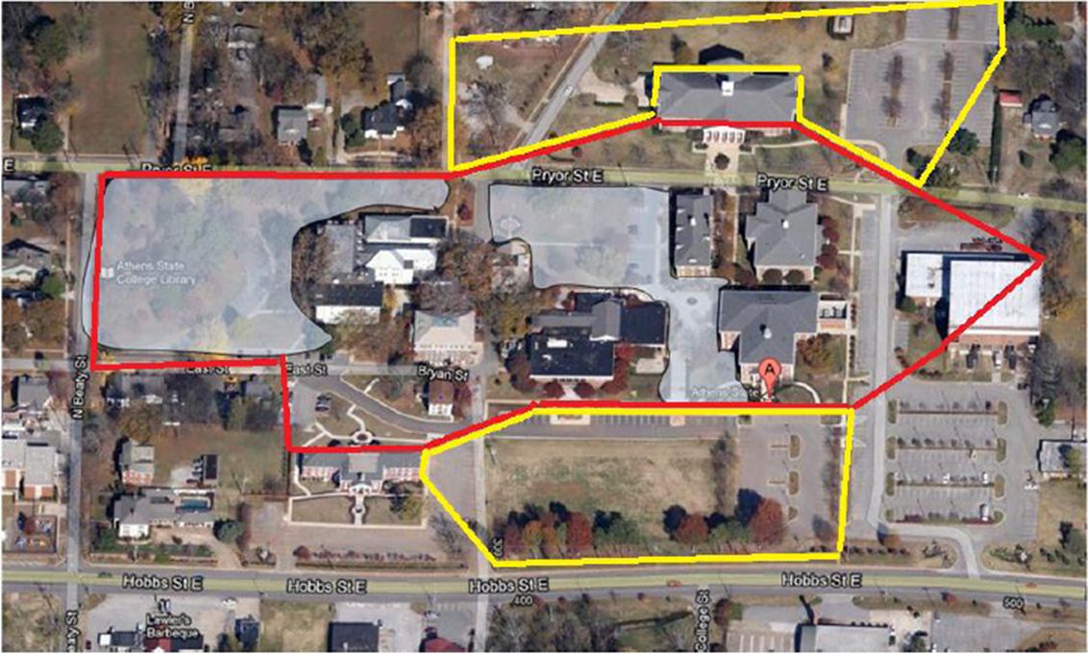
WIRELESS FOOTPRINT

Slide 31
DR. ROBERT WHITE
Presiding Officer
Faculty Senate

Slide 32
MR. DAMON LARES
Presiding Officer
Staff Senate

Slide 33
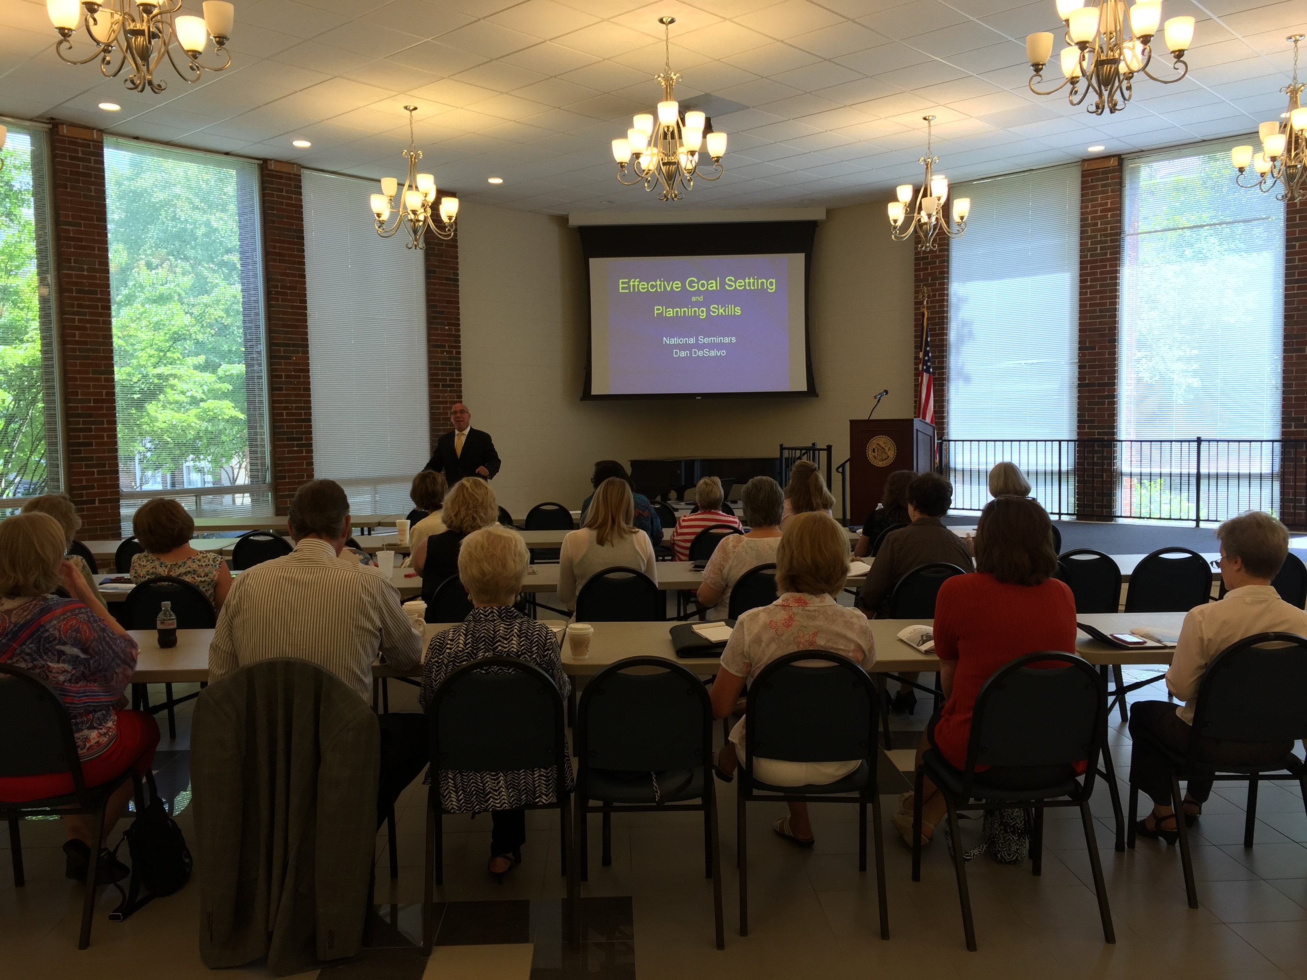
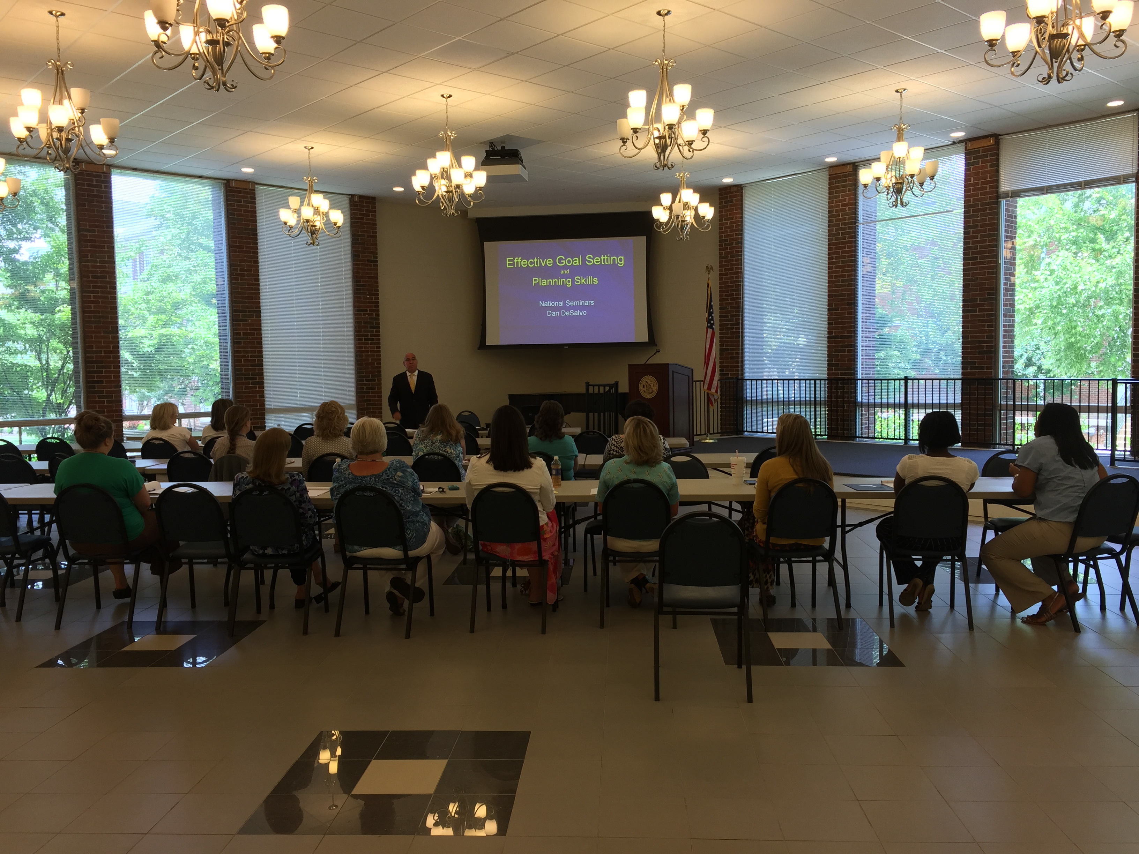
PROFESSIONAL DEVELOPMENT
June 16, 2015
Speaker: Dan DeSalvo
Topic: Effective Goal-setting
and Planning Skills

Slide 34
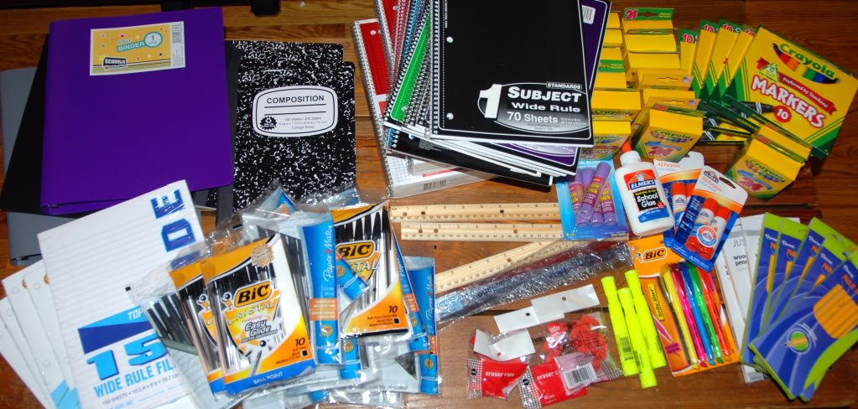
COMMUNITY OUTREACH
School Supply Drive
DHR of Limestone County
All school supplies needed

Slide 35
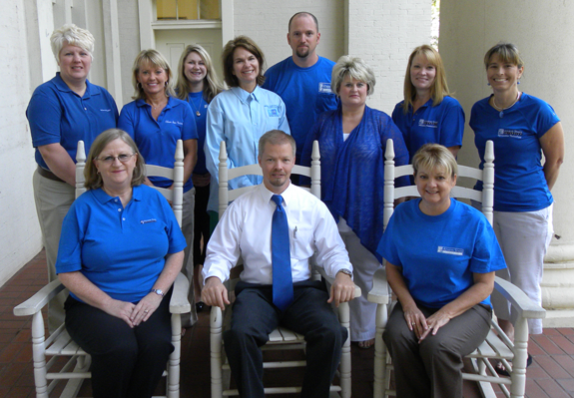
UPCOMING EVENTS
Staff Senate
Nominations – July 9th - August 12th
Elections – August 17th - 28th
New Senate - Starts September 1st

Slide 36
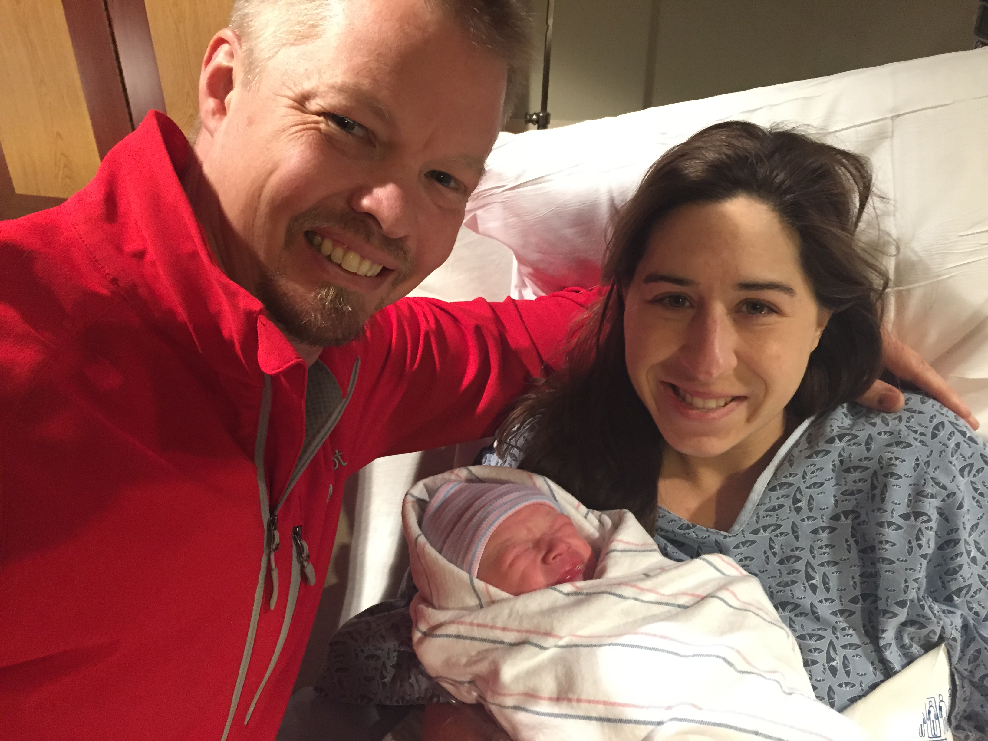
BABY!!
Winston Kennedy Lares

Slide 37
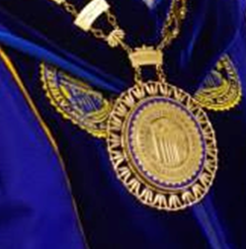
DR. ROBERT GLENN
President

Slide 38
CAPITAL CAMPAIGN UPDATE
Cash and Non-Cash Contributions
June 1, 2012 – May 31, 2015
$2,109,392
Outstanding Pledges as of
May 31, 2015
$1,431,062
Total of Cash and Non-Cash Contributions and Pledges
$3,540,454

Slide 39
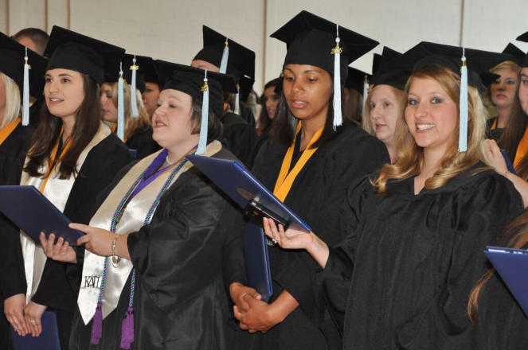
ANNOUNCEMENTS
Summer 2015
Commencement Ceremonies
Saturday, August 1, 2015
9:00 am
Founders Green
Speaker: Ms. Donna Coleman
President/CEO
Aetos Systems, Inc.
Commencement Recognition and Reception Celebration
50th Year Anniversary
of the
Class of 1965

Slide 40
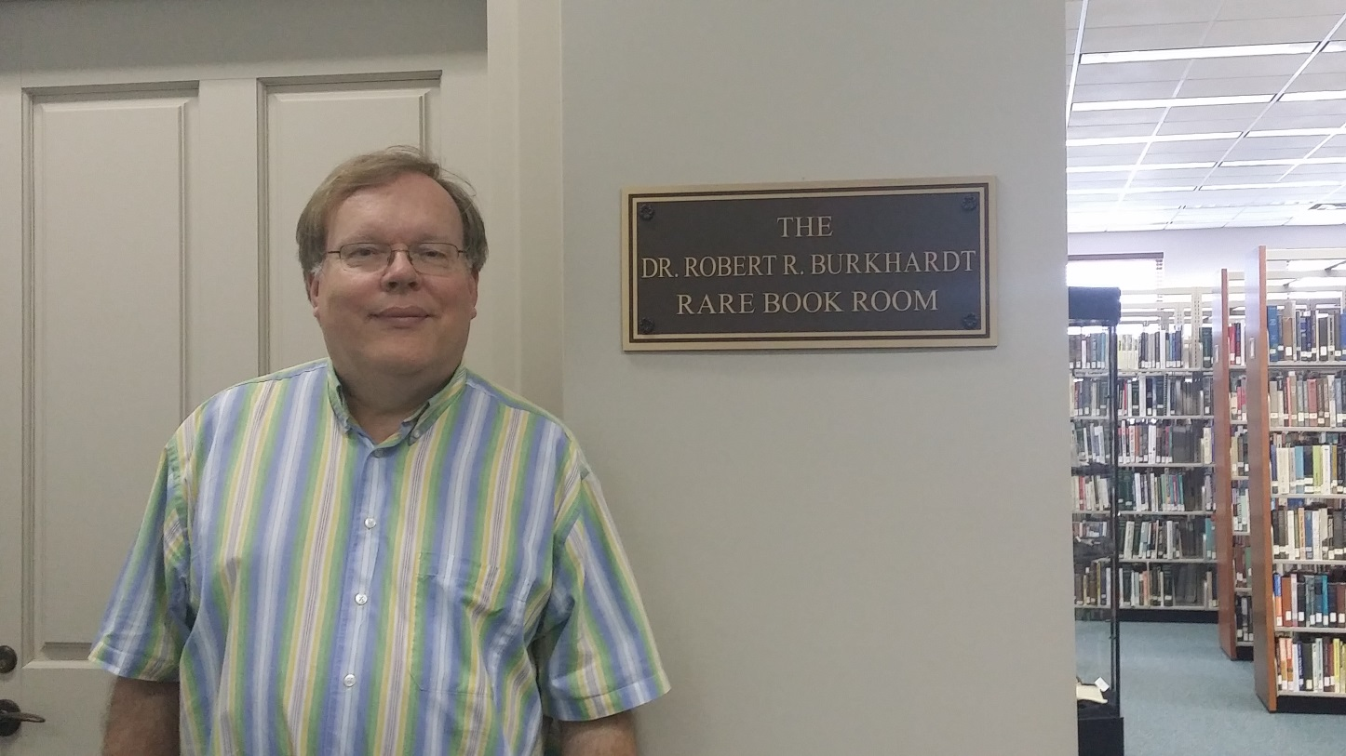
ANNOUNCEMENTS
Dr. Robert Burkhardt
Rare Book Room
Library

Slide 41
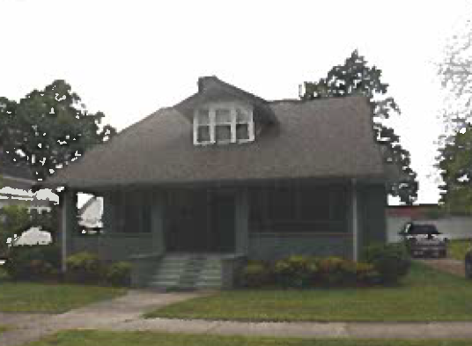
ANNOUNCEMENTS
Purchase of Property
307 North Beaty Street
$290,000

